Slide 1
Equity Strategic Framework
Board of Higher Education Meeting – January 22, 2019

Slide 2
Vision Statement
Equity Strategic Framework
The Massachusetts Board of Higher Education aims to sustain and expand on Massachusetts’ unique leadership position in higher education as defined by the strength and reputation of our private and public postsecondary institutions and our nation-leading level of attainment among our adult citizens.
To further realize those goals and to ensure that public higher education opens doors of opportunity and fulfilment for traditionally underserved populations…
We elect to make our top statewide policy and performance priority:
Significantly raise the enrollment, attainment and long-term success outcomes among under-represented student populations.
We intend this equity lens priority to guide campus and system performance measurement and promote initiatives and policies that collectively expand success for residents and for our economy and society.

Slide 3
When we look at Massachusetts as a whole, there is much to celebrate

Slide 4
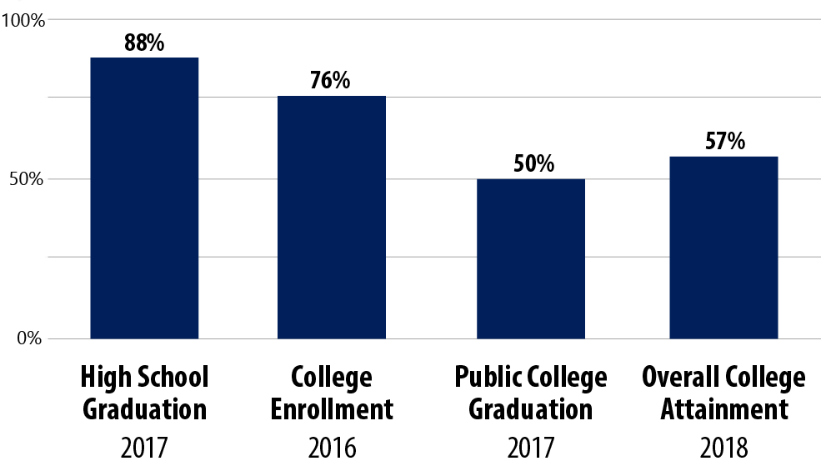
Massachusetts tops the nation in many key education indicators
MA Key Education Indicators: Statewide
See indicator definitions and data sources on Slide 21.
Notes:
Notes:
Definitions of these rates are on Slide 23.
We don’t have comparison data for the Public College Graduation metric but, based on similar metrics, expect the Massachusetts rate would be on par with the U.S. average.

Slide 5
But a closer look at these indicators by race/ethnicity and gender tells a different story

Slide 6
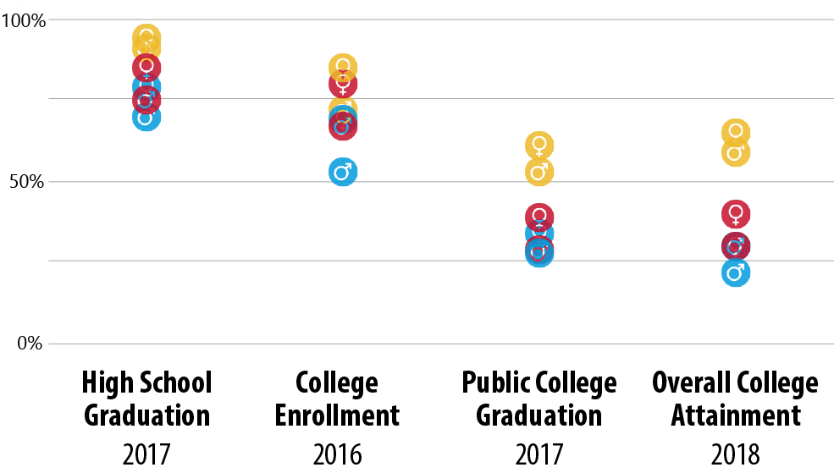
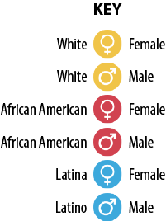
The rates vary significantly by race/ethnicity and gender
MA Key Education Indicators: By Race/Ethnicity & Gender
MA
MA
MA
MA
Notes:
Note: If anyone asks about the other subgroups’ specific rates, see Slide 22.

Slide 7
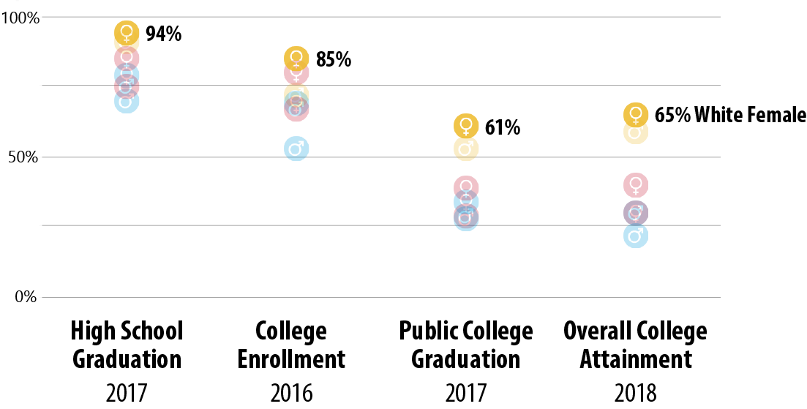
White females consistently rank at the top of their peers
MA Key Education Indicators: By Race/Ethnicity & Gender
Notes:
Note: If anyone asks about the other subgroups’ specific rates, see Slide 22.

Slide 8
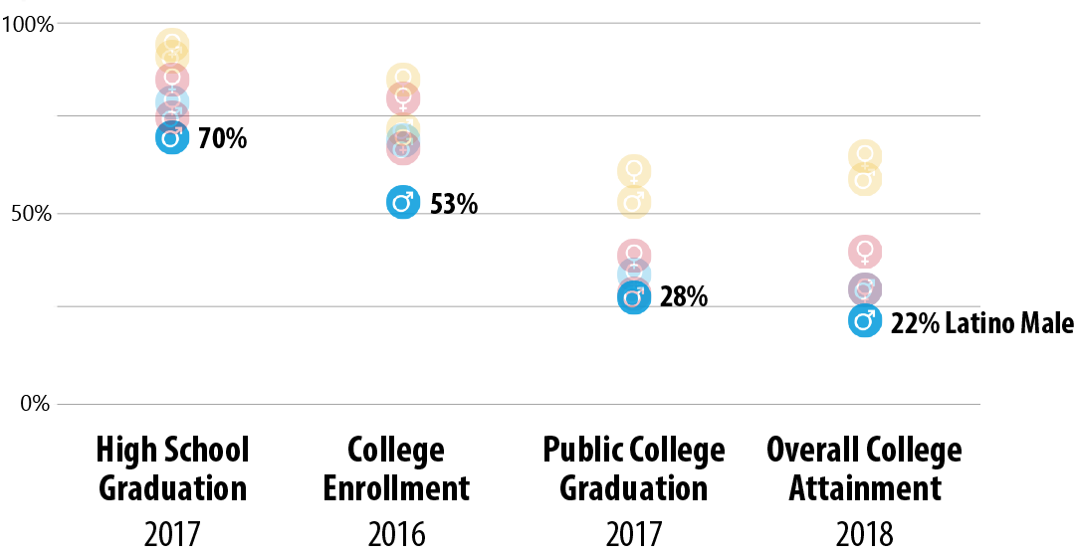
And Latino males consistently rank at the bottom
MA Key Education Indicators: By Race/Ethnicity & Gender
Notes:
Note: If anyone asks about the other subgroups’ specific rates, see Slide 22.

Slide 9
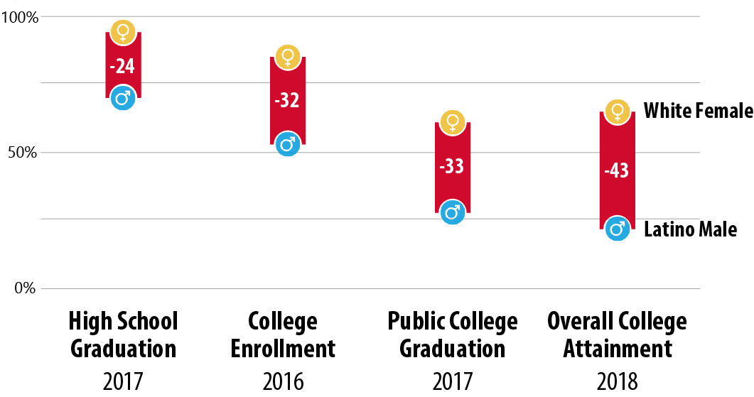
The gaps are large
MA Key Education Indicators: By Race/Ethnicity & Gender

Slide 10
Trend data show these disparities have been persistent

Slide 11
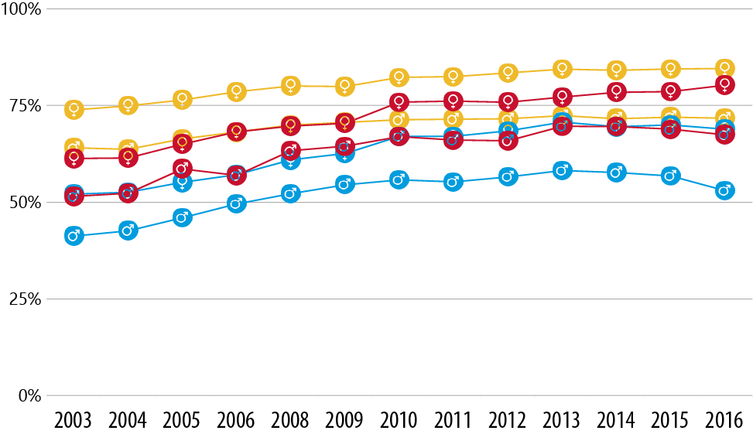
And in the case of college-going rates…
College Enrollment Rates: By Race/Ethnicity & Gender

Slide 12
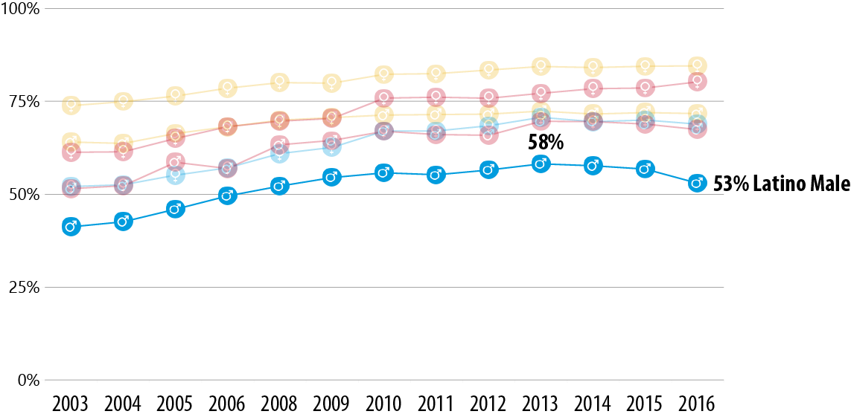
… the rate for Latino males is actually declining
College Enrollment Rates: By Race/Ethnicity & Gender
Notes:
Note: The decline might be partially explained by the recovery from the recession. With more jobs available in today’s economy, more Latinos may be choosing to work rather than enroll in college after high school.

Slide 13
Coupled with population projections for Massachusetts, these findings give even more cause for concern

Slide 14
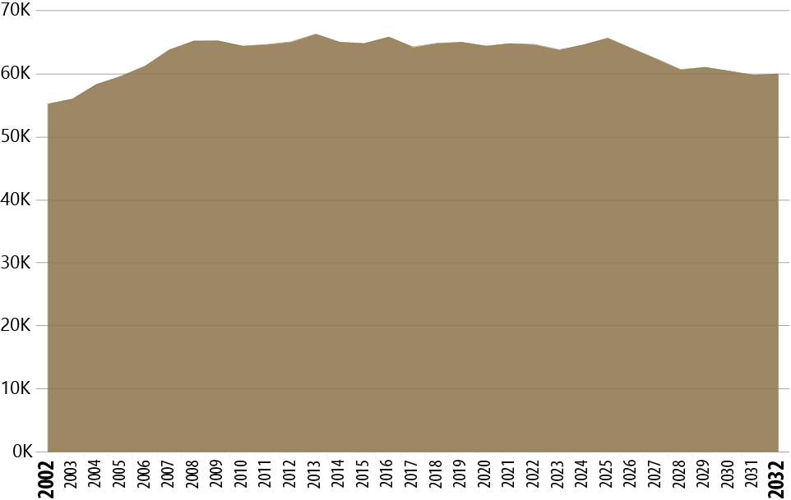
Not only will Massachusetts be seeing a decline in overall numbers of HS grads…
MA Public HS Graduating Classes
Today

Slide 15
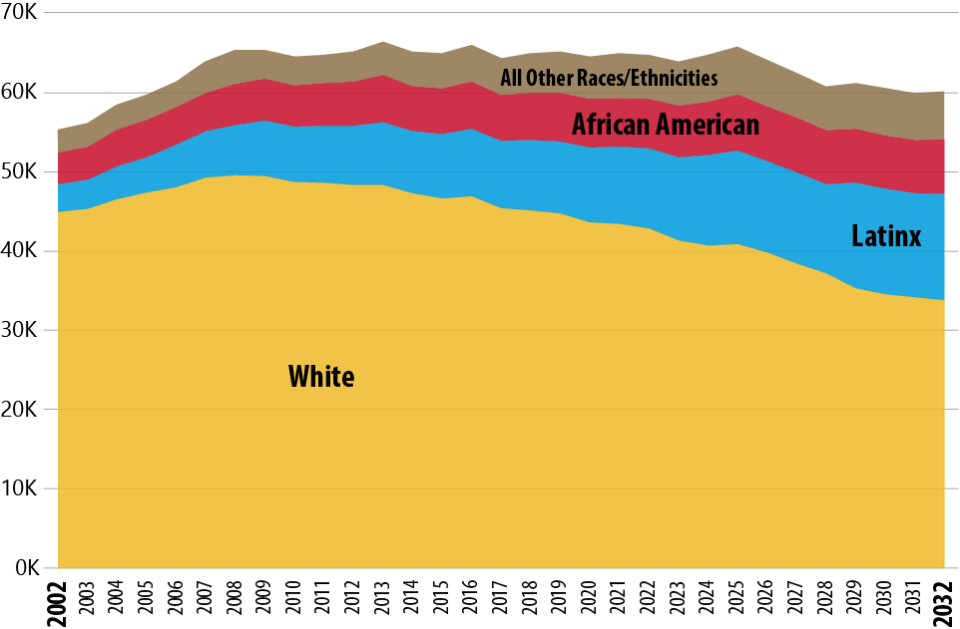
… but Latinx students also represent a rapidly growing segment of the pipeline
MA Public HS Graduating Classes: By Race/Ethnicity

Slide 16
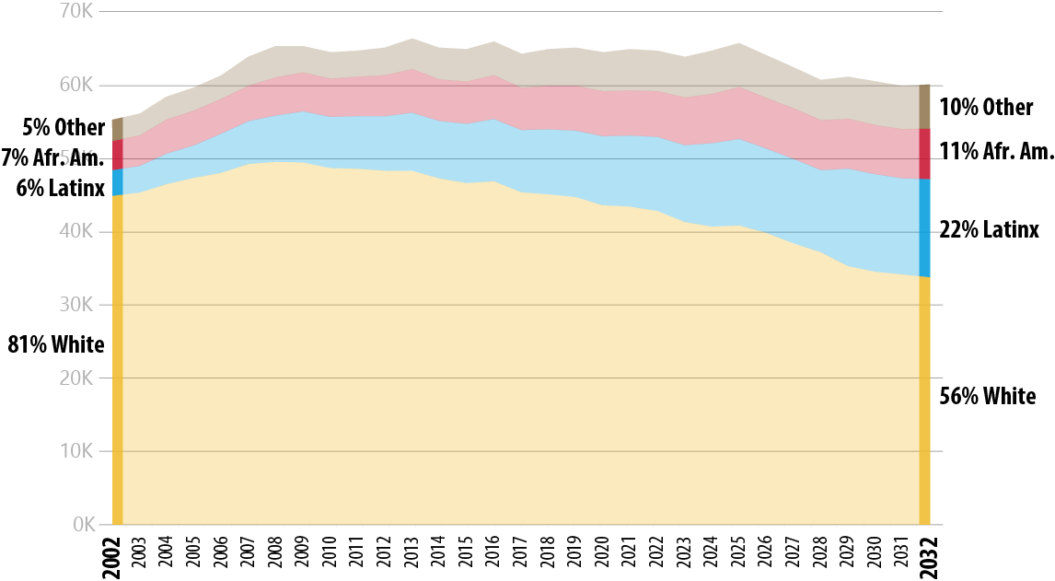
By 2032, nearly 1 in 4 students in the pipeline will be Latinx
MA Public HS Graduating Classes: By Race/Ethnicity

Slide 17
Programs like 100 Males to College provide additional academic supports for motivated but underprivileged students, with an emphasis on males of color

Slide 18
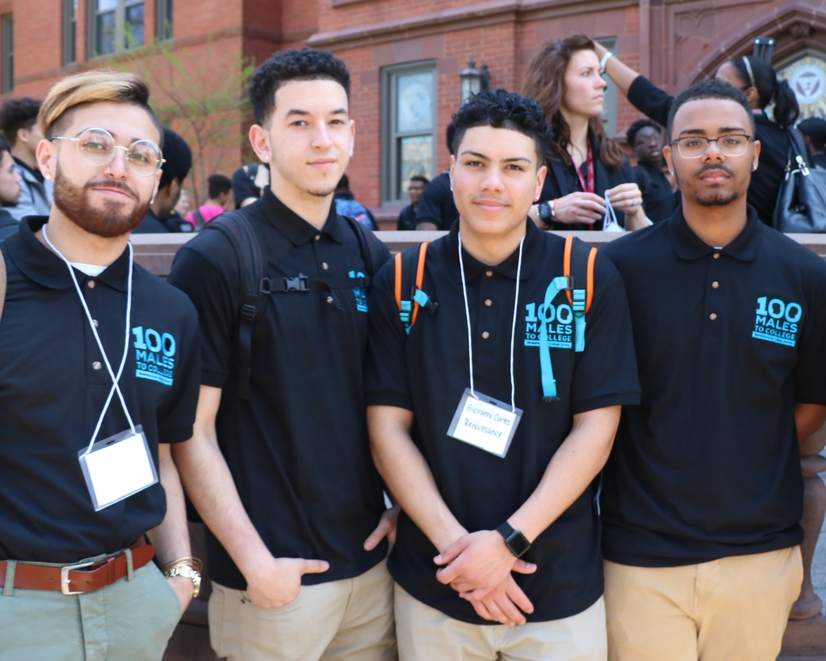
100 Males to College is having an impact on the students it serves
Participants who have enrolled in college after HS graduation
SPRINGFIELD Founded 2015
96%
FRAMINGHAM Founded 2016
92%
Notes:
Notes:
I’ve asked Keith if he can tell us what year(s) this data is from.

Slide 19
Next Steps
Equity Statewide Strategic Framework
Spring 2019
Convene Advisory Board
Summer 2019
Campuses submit commitments and efforts related to closing equity gaps
Fall 2019
Provide feedback to campuses and request revisions. BHE retreat focused on systemwide strategic framework and review goals, baselines, and targets
Spring 2020
Systemwide convening
Convene Executive Committee
Engage external support
Release guidelines on campus commitments and efforts related to closing equity gaps
DHE staff identify major projects to advance goals and objectives
Convene Advisory Board and Executive Committee
Propose systemwide strategic framework to BHE in December

Slide 20
Next Steps
Equity Statewide Strategic Framework
Spring 2019
Convene Advisory Board
Summer 2019
Campuses submit commitments and efforts related to closing equity gaps
Fall 2019
Provide feedback to campuses and request revisions. BHE retreat focused on systemwide strategic framework and review goals, baselines, and targets
Spring 2020
Systemwide convening
Convene Executive Committee
Engage external support
Release guidelines on campus commitments and efforts related to closing equity gaps
DHE staff identify major projects to advance goals and objectives
Convene Advisory Board and Executive Committee
Propose systemwide strategic framework to BHE in December

Slide 21
Notes: Key Education Indicators
Equity Statewide Strategic Framework
High School Graduation | Definition: Percentage of 9th graders in Massachusetts public high schools in 2013–14 who graduated high school by 2017.
 | Source: DESE
College Enrollment | Definition: Percentage of 2016 Massachusetts public high school graduates who enrolled in college within 16 months after high school graduation.
 | Source: DESE, National Student Clearinghouse
Public College Graduation | Definition: Percentage of first-time, degree-seeking students who initially enrolled at a Massachusetts public college or university in fall 2011 and graduated from any U.S. higher education institution by 2017.
 | Source: DHE, National Student Clearinghouse
Overall College Attainment | Definition: Percentage of 2018 Massachusetts residents who possess a college degree (associate or higher).
 | Source: Current Population Survey, U.S. Census Bureau

